Slide 1
CSE 4109: Artificial Intelligence
Natural Language Processing-NLP
M.M.A. Hashem, PhD
Professor,
Dept. of Computer Science and Engineering
Khulna University of Engineering & Technology (KUET)
Khulna 9203, Bangladesh
Email; hashem@cse.kuet.ac.bd
Cell Phone: +880 1714 003949
Adapted from slides by
Raymond J. Mooney
University of Texas at Austin

Slide 2
Why is NLP included in an Artificial Intelligence Course?
Natural Language Processing (NLP) is included in an Artificial Intelligence (AI) course because understanding and processing human language is one of the most essential capabilities of intelligent systems. AI aims to simulate human intelligence, and language is the primary medium through which humans communicate, reason, and share knowledge.
NLP-Prof. M.M.A. Hashem

Slide 3
Natural Language Processing
NLP is the branch of computer science focused on developing systems that allow computers to communicate with people using everyday language.
Also called Computational Linguistics
  Also concerns how computational methods can aid the understanding of human language
NLP-Prof. M.M.A. Hashem

Slide 4
Communication
The goal in the production and comprehension of natural language is communication.
Communication for the Speaker:
  Intention: Decide when and what information should be transmitted (a.k.a. strategic generation). May require planning and reasoning about agents’ goals and beliefs.
  Generation: Translate the information to be communicated (in internal logical representation or “language of thought”) into string of words in desired natural language (a.k.a. tactical generation).
  Synthesis: Output the string in desired modality, text or speech.
NLP-Prof. M.M.A. Hashem

Slide 5
Communication (cont)
Communication for the Hearer:
  Perception: Map input modality to a string of words, e.g. optical character recognition (OCR) or speech recognition.
  Analysis: Determine the information content of the string.
    Syntactic interpretation (parsing): Find the correct parse tree showing the phrase structure of the string.
    Semantic Interpretation: Extract the (literal) meaning of the string (logical form).
    Pragmatic Interpretation: Consider effect of the overall context on altering the literal meaning of a sentence.
  Incorporation: Decide whether or not to believe the content of the string and add it to the KB.
NLP-Prof. M.M.A. Hashem

Slide 6
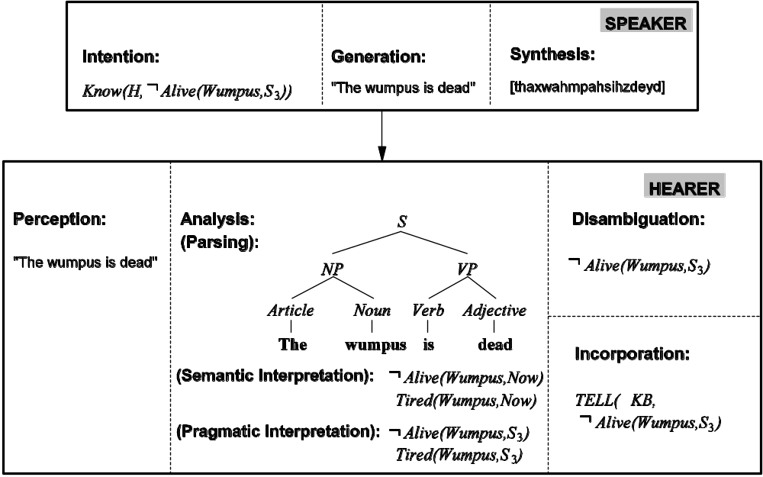
Communication (cont)
NLP-Prof. M.M.A. Hashem

Slide 7
Syntax, Semantic, Pragmatics
Syntax concerns the proper ordering of words and its affect on meaning.
  The dog bit the boy.
  The boy bit the dog.
  * Bit boy dog the the.
  Colorless green ideas sleep furiously.
Semantics concerns the (literal) meaning of words, phrases, and sentences.
  “plant” as a photosynthetic organism
  “plant” as a manufacturing facility
  “plant” as the act of sowing
Pragmatics concerns the overall communicative and social context and its effect on interpretation.
  The ham sandwich wants another beer. (co-reference, anaphora)
  John thinks vanilla. (ellipsis)
NLP-Prof. M.M.A. Hashem

Slide 8
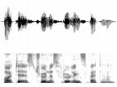
Modular Comprehension
Pragmatics
Acoustic/
Phonetic
Syntax
Semantics
sound
waves
words
parse
trees
literal
meaning
meaning
(contextualized)
NLP-Prof. M.M.A. Hashem

Slide 9
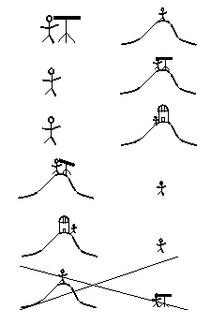
Ambiguity
Natural language is highly ambiguous and must be disambiguated.
  I saw the man on the hill with a telescope.
  I saw the Grand Canyon flying to LA.
  Time flies like an arrow.
  Horse flies like a sugar cube.
  Time runners like a coach.
  Time cars like a Porsche.
NLP-Prof. M.M.A. Hashem

Slide 10
Ambiguity is Ubiquitous
Speech Recognition
  “recognize speech” vs. “wreck a nice beach”
  “youth in Asia” vs. “euthanasia”
Syntactic Analysis
  “I ate spaghetti with chopsticks” vs. “I ate spaghetti with meatballs.”
Semantic Analysis
  “The dog is in the pen.” vs. “The ink is in the pen.”
  “I put the plant in the window” vs. “Ford put the plant in Mexico”
Pragmatic Analysis
  From “The Pink Panther Strikes Again”:
  Clouseau: Does your dog bite?
  Hotel Clerk: No.
  Clouseau: [bowing down to pet the dog] Nice doggie.
  [Dog barks and bites Clouseau in the hand]
  Clouseau: I thought you said your dog did not bite!
  Hotel Clerk: That is not my dog.
NLP-Prof. M.M.A. Hashem

Slide 11
Ambiguity is Explosive
Ambiguities compound to generate enormous numbers of possible interpretations.
In English, a sentence ending in n prepositional phrases has over 2^{n} syntactic interpretations (cf. Catalan numbers).
  “I saw the man with the telescope”: 2 parses
  “I saw the man on the hill with the telescope.”: 5 parses
  “I saw the man on the hill in Texas with the telescope”: 14 parses
  “I saw the man on the hill in Texas with the telescope at noon.”: 42 parses
  “I saw the man on the hill in Texas with the telescope at noon on Monday” 132 parses
NLP-Prof. M.M.A. Hashem

Slide 12
Humor and Ambiguity
Many jokes rely on the ambiguity of language:
  Groucho Marx: One morning I shot an elephant in my pajamas. How he got into my pajamas, I’ll never know.
  She criticized my apartment, so I knocked her flat.
  Noah took all of the animals on the ark in pairs. Except the worms, they came in apples.
  Policeman to little boy: “We are looking for a thief with a bicycle.” Little boy: “Wouldn’t you be better using your eyes.”
  Why is the teacher wearing sun-glasses. Because the class is so bright.
NLP-Prof. M.M.A. Hashem

Slide 13
Natural Languages vs. Computer Languages
Ambiguity is the primary difference between natural and computer languages.
Formal programming languages are designed to be unambiguous, i.e. they can be defined by a grammar that produces a unique parse for each sentence in the language.
Programming languages are also designed for efficient (deterministic) parsing, i.e. they are deterministic context-free languages (DCLFs).
  A sentence in a DCFL can be parsed in O(n) time where n is the length of the string.
NLP-Prof. M.M.A. Hashem

Slide 14
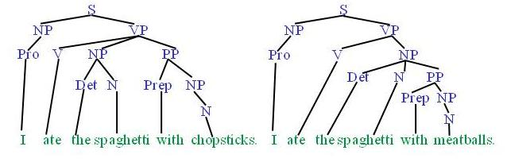
Syntactic Parsing
Produce the correct syntactic parse tree for a sentence.
NLP-Prof. M.M.A. Hashem

Slide 15
Context Free Grammars (CFG)
N a set of non-terminal symbols (or variables)
Σ a set of terminal symbols (disjoint from N)
R a set of productions or rules of the form A→β, where A is a non-terminal and β is a string of symbols from (Σ∪ N)*
S, a designated non-terminal called the start symbol
NLP-Prof. M.M.A. Hashem

Slide 16
Simple CFG for ATIS English
Grammar
Lexicon
S → NP VP
S → Aux NP VP
S → VP
NP → Pronoun
NP → Proper-Noun
NP → Det Nominal
Nominal → Noun
Nominal → Nominal Noun
Nominal → Nominal PP
VP → Verb
VP → Verb NP
VP → VP PP
PP → Prep NP
Det → the | a | that | this
Noun → book | flight | meal | money
Verb → book | include | prefer
Pronoun → I | he | she | me
Proper-Noun → Houston | NWA
Aux → does
Prep → from | to | on | near | through
NLP-Prof. M.M.A. Hashem

Slide 17
Sentence Generation
Sentences are generated by recursively rewriting the start symbol using the productions until only terminals symbols remain.
S
Derivation
or
Parse Tree
VP
Verb NP
book
Det Nominal
the
Nominal PP
Noun
Prep NP
flight
through
Proper-Noun
NLP-Prof. M.M.A. Hashem
Houston

Slide 18
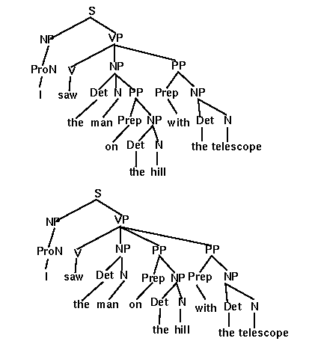
Parse Trees and Syntactic Ambiguity
If a sentence has more than one possible derivation (parse tree) it is said to be syntactically ambiguous.
NLP-Prof. M.M.A. Hashem

Slide 19
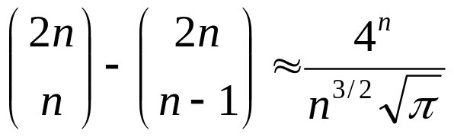
Prepositional Phrase Attachment Explosion
A transitive English sentence ending in m prepositional phrases has at least 2^{m} parses.
I saw the man on the hill with a telescope on Tuesday in Austin….
The exact number of parses is given by the Catalan numbers (where n=m+1)
1, 2, 5, 14, 132, 429, 1430, 4862, 16796, ……
NLP-Prof. M.M.A. Hashem

Slide 20
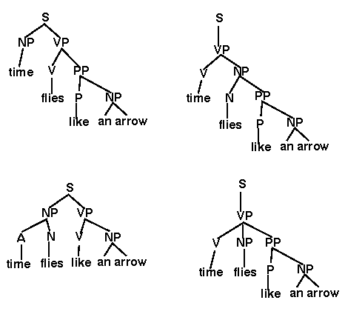
Spurious Ambiguity
Most parse trees of most NL sentences make no sense.
NLP-Prof. M.M.A. Hashem

Slide 21
Parsing
Given a string of non-terminals and a CFG, determine if the string can be generated by the CFG.
  Also return a parse tree for the string
  Also return all possible parse trees for the string
Must search space of derivations for one that derives the given string.
  Top-Down Parsing: Start searching space of derivations for the start symbol.
  Bottom-up Parsing: Start search space of reverse deivations from the terminal symbols in the string.
NLP-Prof. M.M.A. Hashem

Slide 22
Parsing Example
S
VP
Verb NP
book that flight
book
Det Nominal
that
Noun
flight
NLP-Prof. M.M.A. Hashem

Slide 23
Top Down Parsing
S
NP VP
Pronoun
NLP-Prof. M.M.A. Hashem

Slide 24
Top Down Parsing
S
NP VP
Pronoun
X
book
NLP-Prof. M.M.A. Hashem

Slide 25
Top Down Parsing
S
NP VP
ProperNoun
NLP-Prof. M.M.A. Hashem

Slide 26
Top Down Parsing
S
NP VP
ProperNoun
X
book
NLP-Prof. M.M.A. Hashem

Slide 27
Top Down Parsing
S
NP VP
Det Nominal
NLP-Prof. M.M.A. Hashem

Slide 28
Top Down Parsing
S
NP VP
Det Nominal
X
book
NLP-Prof. M.M.A. Hashem

Slide 29
Top Down Parsing
S
Aux NP VP
NLP-Prof. M.M.A. Hashem

Slide 30
Top Down Parsing
S
Aux NP VP
X
book
NLP-Prof. M.M.A. Hashem

Slide 31
Top Down Parsing
S
VP
NLP-Prof. M.M.A. Hashem

Slide 32
Top Down Parsing
S
VP
Verb
NLP-Prof. M.M.A. Hashem

Slide 33
Top Down Parsing
S
VP
Verb
book
NLP-Prof. M.M.A. Hashem

Slide 34
Top Down Parsing
S
VP
Verb
X
book
that
NLP-Prof. M.M.A. Hashem

Slide 35
Top Down Parsing
S
VP
Verb NP
NLP-Prof. M.M.A. Hashem

Slide 36
Top Down Parsing
S
VP
Verb NP
book
NLP-Prof. M.M.A. Hashem

Slide 37
Top Down Parsing
S
VP
Verb NP
book
Pronoun
NLP-Prof. M.M.A. Hashem

Slide 38
Top Down Parsing
S
VP
Verb NP
book
Pronoun
X
that
NLP-Prof. M.M.A. Hashem

Slide 39
Top Down Parsing
S
VP
Verb NP
book
ProperNoun
NLP-Prof. M.M.A. Hashem

Slide 40
Top Down Parsing
S
VP
Verb NP
book
ProperNoun
X
that
NLP-Prof. M.M.A. Hashem

Slide 41
Top Down Parsing
S
VP
Verb NP
book
Det Nominal
NLP-Prof. M.M.A. Hashem

Slide 42
Top Down Parsing
S
VP
Verb NP
book
Det Nominal
that
NLP-Prof. M.M.A. Hashem

Slide 43
Top Down Parsing
S
VP
Verb NP
book
Det Nominal
that
Noun
NLP-Prof. M.M.A. Hashem

Slide 44
Top Down Parsing
S
VP
Verb NP
book
Det Nominal
that
Noun
flight
NLP-Prof. M.M.A. Hashem

Slide 45
Bottom Up Parsing
book that flight
NLP-Prof. M.M.A. Hashem

Slide 46
Bottom Up Parsing
Noun
book that flight
NLP-Prof. M.M.A. Hashem

Slide 47
Bottom Up Parsing
Nominal
Noun
book that flight
NLP-Prof. M.M.A. Hashem

Slide 48
Bottom Up Parsing
Nominal
Nominal Noun
Noun
book that flight
NLP-Prof. M.M.A. Hashem

Slide 49
Bottom Up Parsing
Nominal
Nominal Noun
X
Noun
book that flight
NLP-Prof. M.M.A. Hashem

Slide 50
Bottom Up Parsing
Nominal
Nominal PP
Noun
book that flight
NLP-Prof. M.M.A. Hashem

Slide 51
Bottom Up Parsing
Nominal
Nominal PP
Noun
Det
book that flight
NLP-Prof. M.M.A. Hashem

Slide 52
Bottom Up Parsing
Nominal
Nominal PP
NP
Noun
Det
Nominal
book that flight
NLP-Prof. M.M.A. Hashem

Slide 53
Bottom Up Parsing
Nominal
Nominal PP
NP
Noun
Det
Nominal
book that
Noun
flight
NLP-Prof. M.M.A. Hashem

Slide 54
Bottom Up Parsing
Nominal
Nominal PP
NP
Noun
Det
Nominal
book that
Noun
flight
NLP-Prof. M.M.A. Hashem

Slide 55
Bottom Up Parsing
Nominal
Nominal PP
S
NP
VP
Noun
Det
Nominal
book that
Noun
flight
NLP-Prof. M.M.A. Hashem

Slide 56
Bottom Up Parsing
Nominal
Nominal PP
S
NP
VP
Noun
Det
Nominal
X
book that
Noun
flight
NLP-Prof. M.M.A. Hashem

Slide 57
Bottom Up Parsing
Nominal
Nominal PP
X
NP
Noun
Det
Nominal
book that
Noun
flight
NLP-Prof. M.M.A. Hashem

Slide 58
Bottom Up Parsing
NP
Verb
Det
Nominal
book that
Noun
flight
NLP-Prof. M.M.A. Hashem

Slide 59
Bottom Up Parsing
VP
NP
Verb
Det
Nominal
book that
Noun
flight
NLP-Prof. M.M.A. Hashem

Slide 60
Bottom Up Parsing
S
VP
NP
Verb
Det
Nominal
book that
Noun
flight
NLP-Prof. M.M.A. Hashem

Slide 61
Bottom Up Parsing
S
X
VP
NP
Verb
Det
Nominal
book that
Noun
flight
NLP-Prof. M.M.A. Hashem

Slide 62
Bottom Up Parsing
VP
VP
PP
NP
Verb
Det
Nominal
book that
Noun
flight
NLP-Prof. M.M.A. Hashem

Slide 63
Bottom Up Parsing
VP
VP
PP
X
NP
Verb
Det
Nominal
book that
Noun
flight
NLP-Prof. M.M.A. Hashem

Slide 64
Bottom Up Parsing
VP
NP
NP
Verb
Det
Nominal
book that
Noun
flight
NLP-Prof. M.M.A. Hashem

Slide 65
Bottom Up Parsing
VP
NP
Verb
Det
Nominal
book that
Noun
flight
NLP-Prof. M.M.A. Hashem

Slide 66
Bottom Up Parsing
S
VP
NP
Verb
Det
Nominal
book that
Noun
flight
NLP-Prof. M.M.A. Hashem

Slide 67
Top Down vs. Bottom Up
Top down never explores options that will not lead to a full parse, but can explore many options that never connect to the actual sentence.
Bottom up never explores options that do not connect to the actual sentence but can explore options that can never lead to a full parse.
Relative amounts of wasted search depend on how much the grammar branches in each direction.
NLP-Prof. M.M.A. Hashem

Slide 68
Syntactic Parsing & Ambiguity
Just produces all possible parse trees.
Does not address the important issue of ambiguity resolution.
NLP-Prof. M.M.A. Hashem

Slide 69
Statistical Parsing
Statistical parsing uses a probabilistic model of syntax in order to assign probabilities to each parse tree.
Provides principled approach to resolving syntactic ambiguity.
Allows supervised learning of parsers from tree-banks of parse trees provided by human linguists.
Also allows unsupervised learning of parsers from unannotated text, but the accuracy of such parsers has been limited.
NLP-Prof. M.M.A. Hashem

Slide 70
Probabilistic Context Free Grammar
(PCFG)
A PCFG is a probabilistic version of a CFG where each production has a probability.
Probabilities of all productions rewriting a given non-terminal must add to 1, defining a distribution for each non-terminal.
String generation is now probabilistic where production probabilities are used to non-deterministically select a production for rewriting a given non-terminal.
NLP-Prof. M.M.A. Hashem

Slide 71
Simple PCFG for ATIS English
Grammar
Prob
Lexicon
S → NP VP
S → Aux NP VP
S → VP
NP → Pronoun
NP → Proper-Noun
NP → Det Nominal
Nominal → Noun
Nominal → Nominal Noun
Nominal → Nominal PP
VP → Verb
VP → Verb NP
VP → VP PP
PP → Prep NP
0.8
0.1
0.1
0.2
0.2
0.6
0.3
0.2
0.5
0.2
0.5
0.3
1.0
Det → the | a | that | this
0.6 0.2 0.1 0.1
Noun → book | flight | meal | money
0.1 0.5 0.2 0.2
Verb → book | include | prefer
0.5 0.2 0.3
Pronoun → I | he | she | me
0.5 0.1 0.1 0.3
Proper-Noun → Houston | NWA
0.8 0.2
Aux → does
1.0
Prep → from | to | on | near | through
0.25 0.25 0.1 0.2 0.2
+
1.0
+
1.0
+
1.0
+
1.0
NLP-Prof. M.M.A. Hashem

Slide 72
Sentence Probability
Assume productions for each node are chosen independently.
Probability of derivation is the product of the probabilities of its productions.
P(D₁) = 0.1 x 0.5 x 0.5 x 0.6 x 0.6 x
0.5 x 0.3 x 1.0 x 0.2 x 0.2 x
0.5 x 0.8
⁼ 0.0000216
S
D₁
0.1
VP
0.5
Verb NP
0.6
0.5
book
Det Nominal
0.5
0.6
the
Nominal PP
1.0
0.3
Noun
Prep NP
0.2
0.5
0.2
flight
through
Proper-Noun
0.8
Houston
NLP-Prof. M.M.A. Hashem

Slide 73
Syntactic Disambiguation
Resolve ambiguity by picking most probable parse tree.
S
D₂
P(D₂) = 0.1 x 0.3 x 0.5 x 0.6 x 0.5 x
0.6 x 0.3 x 1.0 x 0.5 x 0.2 x
0.2 x 0.8
⁼ 0.00001296
0.1
VP
0.3
VP
0.5
Verb NP
0.6
0.5
PP
book
Det Nominal
1.0
0.6
0.3
the
Noun
Prep NP
0.2
0.5
0.2
flight
through
Proper-Noun
0.8
Houston
NLP-Prof. M.M.A. Hashem

Slide 74
Sentence Probability
Probability of a sentence is the sum of the probabilities of all of its derivations.
P(“book the flight through Houston”) =
P(D₁) + P(D₂) = 0.0000216 + 0.00001296
= 0.00003456
NLP-Prof. M.M.A. Hashem

Slide 75
Three Useful PCFG Tasks
Observation likelihood: To classify and order sentences.
Most likely derivation: To determine the most likely parse tree for a sentence.
Maximum likelihood training: To train a PCFG to fit empirical training data.
NLP-Prof. M.M.A. Hashem

Slide 76
PCFG: Observation Likelihood
What is the probability that a given string is produced by a given PCFG.
Can use a PCFG as a language model to choose between alternative sentences for speech recognition or machine translation.
S → NP VP
S → VP
NP → Det A N
NP → NP PP
NP → PropN
A → ε
A → Adj A
PP → Prep NP
VP → V NP
VP → VP PP
0.9
0.1
0.5
0.3
0.2
0.6
0.4
1.0
0.7
0.3
O₁
?
The dog big barked.
?
The big dog barked
O₂
P(O₂ | English) > P(O₁ | English) ?
English
NLP-Prof. M.M.A. Hashem

Slide 77
PCFG: Most Likely Derivation
What is the most probable derivation (parse tree) for a sentence.
John liked the dog in the pen.
S → NP VP
S → VP
NP → Det A N
NP → NP PP
NP → PropN
A → ε
A → Adj A
PP → Prep NP
VP → V NP
VP → VP PP
0.9
0.1
0.5
0.3
0.2
0.6
0.4
1.0
0.7
0.3
S
X
NP VP
PCFG
Parser
John V NP PP
liked the dog in the pen
English
NLP-Prof. M.M.A. Hashem

Slide 78
PCFG: Most Likely Derivation
What is the most probable derivation (parse tree) for a sentence.
John liked the dog in the pen.
S → NP VP
S → VP
NP → Det A N
NP → NP PP
NP → PropN
A → ε
A → Adj A
PP → Prep NP
VP → V NP
VP → VP PP
0.9
0.1
0.5
0.3
0.2
0.6
0.4
1.0
0.7
0.3
S
NP VP
PCFG
Parser
John V NP
liked the dog in the pen
English
NLP-Prof. M.M.A. Hashem

Slide 79
PCFG: Supervised Training
If parse trees are provided for training sentences, a grammar and its parameters can be can all be estimated directly from counts accumulated from the tree-bank (with appropriate smoothing).
Tree Bank
S
NP VP
S → NP VP
S → VP
NP → Det A N
NP → NP PP
NP → PropN
A → ε
A → Adj A
PP → Prep NP
VP → V NP
VP → VP PP
0.9
0.1
0.5
0.3
0.2
0.6
0.4
1.0
0.7
0.3
John V NP PP
put the dog in the pen
S
Supervised
PCFG
Training
NP VP
John V NP PP
put the dog in the pen
.
.
.
English
NLP-Prof. M.M.A. Hashem

Slide 80
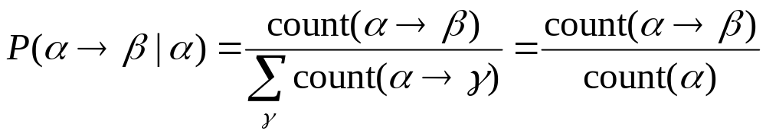
Estimating Production Probabilities
Set of production rules can be taken directly from the set of rewrites in the treebank.
Parameters can be directly estimated from frequency counts in the treebank.
NLP-Prof. M.M.A. Hashem

Slide 81
PCFG: Maximum Likelihood Training
Given a set of sentences, induce a grammar that maximizes the probability that this data was generated from this grammar.
Assume the number of non-terminals in the grammar is specified.
Only need to have an unannotated set of sequences generated from the model. Does not need correct parse trees for these sentences. In this sense, it is unsupervised.
NLP-Prof. M.M.A. Hashem

Slide 82
PCFG: Maximum Likelihood Training
Training Sentences
S → NP VP
S → VP
NP → Det A N
NP → NP PP
NP → PropN
A → ε
A → Adj A
PP → Prep NP
VP → V NP
VP → VP PP
0.9
0.1
0.5
0.3
0.2
0.6
0.4
1.0
0.7
0.3
John ate the apple
A dog bit Mary
Mary hit the dog
John gave Mary the cat.
PCFG
Training
.
.
.
English
NLP-Prof. M.M.A. Hashem

Slide 83
Vanilla PCFG Limitations
Since probabilities of productions do not rely on specific words or concepts, only general structural disambiguation is possible (e.g. prefer to attach PPs to Nominals).
Consequently, vanilla PCFGs cannot resolve syntactic ambiguities that require semantics to resolve, e.g. ate with fork vs. meatballs.
In order to work well, PCFGs must be lexicalized, i.e. productions must be specialized to specific words by including their head-word in their LHS non-terminals (e.g. VP-ate).
NLP-Prof. M.M.A. Hashem

Slide 84
Example of Importance of Lexicalization
A general preference for attaching PPs to NPs rather than VPs can be learned by a vanilla PCFG.
But the desired preference can depend on specific words.
John put the dog in the pen.
S → NP VP
S → VP
NP → Det A N
NP → NP PP
NP → PropN
A → ε
A → Adj A
PP → Prep NP
VP → V NP
VP → VP PP
0.9
0.1
0.5
0.3
0.2
0.6
0.4
1.0
0.7
0.3
S
NP VP
PCFG
Parser
John V NP PP
put the dog in the pen
English
NLP-Prof. M.M.A. Hashem

Slide 85
Example of Importance of Lexicalization
A general preference for attaching PPs to NPs rather than VPs can be learned by a vanilla PCFG.
But the desired preference can depend on specific words.
John put the dog in the pen.
S → NP VP
S → VP
NP → Det A N
NP → NP PP
NP → PropN
A → ε
A → Adj A
PP → Prep NP
VP → V NP
VP → VP PP
0.9
0.1
0.5
0.3
0.2
0.6
0.4
1.0
0.7
0.3
S
X
NP VP
PCFG
Parser
John V NP
put the dog in the pen
English
NLP-Prof. M.M.A. Hashem

Slide 86
Treebanks
English Penn Treebank: Standard corpus for testing syntactic parsing consists of 1.2 M words of text from the Wall Street Journal (WSJ).
Typical to train on about 40,000 parsed sentences and test on an additional standard disjoint test set of 2,416 sentences.
Chinese Penn Treebank: 100K words from the Xinhua news service.
Other corpora existing in many languages, see the Wikipedia article “Treebank”
NLP-Prof. M.M.A. Hashem

Slide 87
First WSJ Sentence
( (S
(NP-SBJ
(NP (NNP Pierre) (NNP Vinken) )
(, ,)
(ADJP
(NP (CD 61) (NNS years) )
(JJ old) )
(, ,) )
(VP (MD will)
(VP (VB join)
(NP (DT the) (NN board) )
(PP-CLR (IN as)
(NP (DT a) (JJ nonexecutive) (NN director) ))
(NP-TMP (NNP Nov.) (CD 29) )))
(. .) ))
NLP-Prof. M.M.A. Hashem

Slide 88
Parsing Evaluation Metrics
PARSEVAL metrics measure the fraction of the constituents that match between the computed and human parse trees. If P is the system’s parse tree and T is the human parse tree (the “gold standard”):
  Recall = (# correct constituents in P) / (# constituents in T)
  Precision = (# correct constituents in P) / (# constituents in P)
Labeled Precision and labeled recall require getting the non-terminal label on the constituent node correct to count as correct.
F₁ is the harmonic mean of precision and recall.
NLP-Prof. M.M.A. Hashem

Slide 89

Computing Evaluation Metrics
Correct Tree T
Computed Tree P
S
S
VP
VP
Verb NP
VP
book
Det Nominal
Verb NP
the
Nominal PP
Det Nominal
PP
book
Noun
Prep NP
the
Noun
Prep NP
flight
through
Proper-Noun
flight
through
Proper-Noun
Houston
Houston
# Constituents: 12
# Constituents: 12
# Correct Constituents: 10
Recall = 10/12= 83.3%
Precision = 10/12=83.3%
F₁ = 83.3%
NLP-Prof. M.M.A. Hashem

Slide 90
Treebank Results
Results of current state-of-the-art systems on the English Penn WSJ treebank are slightly greater than 90% labeled precision and recall.
NLP-Prof. M.M.A. Hashem

Slide 91
Word Sense Disambiguation (WSD)
Words in natural language usually have a fair number of different possible meanings.
  Ellen has a strong interest in computational linguistics.
  Ellen pays a large amount of interest on her credit card.
For many tasks (question answering, translation), the proper sense of each ambiguous word in a sentence must be determined.
NLP-Prof. M.M.A. Hashem

Slide 92
Ambiguity Resolution is Required for Translation
Syntactic and semantic ambiguities must be properly resolved for correct translation:
  “John plays the guitar.” → “John toca la guitarra.”
  “John plays soccer.” → “John juega el fútbol.”
An apocryphal story is that an early MT system gave the following results when translating from English to Russian and then back to English:
  “The spirit is willing but the flesh is weak.” ⇒ “The liquor is good but the meat is spoiled.”
  “Out of sight, out of mind.” ⇒ “Invisible idiot.”
NLP-Prof. M.M.A. Hashem

Slide 93
Word Sense Disambiguation (WSD) as Text Categorization
Each sense of an ambiguous word is treated as a category.
  “play” (verb)
    play-game
    play-instrument
    play-role
  “pen” (noun)
    writing-instrument
    enclosure
Treat current sentence (or preceding and current sentence) as a document to be classified.
  “play”:
    play-game: “John played soccer in the stadium on Friday.”
    play-instrument: “John played guitar in the band on Friday.”
    play-role: “John played Hamlet in the theater on Friday.”
  “pen”:
    writing-instrument: “John wrote the letter with a pen in New York.”
    enclosure: “John put the dog in the pen in New York.”
NLP-Prof. M.M.A. Hashem

Slide 94
Learning for WSD
Assume part-of-speech (POS), e.g. noun, verb, adjective, for the target word is determined.
Treat as a classification problem with the appropriate potential senses for the target word given its POS as the categories.
Encode context using a set of features to be used for disambiguation.
Train a classifier on labeled data encoded using these features.
Use the trained classifier to disambiguate future instances of the target word given their contextual features.
NLP-Prof. M.M.A. Hashem

Slide 95
WSD “line” Corpus
4,149 examples from newspaper articles containing the word “line.”
Each instance of “line” labeled with one of 6 senses from WordNet.
Each example includes a sentence containing “line” and the previous sentence for context.
NLP-Prof. M.M.A. Hashem

Slide 96
Senses of “line”
Product: “While he wouldn’t estimate the sale price, analysts have estimated that it would exceed $1 billion. Kraft also told analysts it plans to develop and test a line of refrigerated entrees and desserts, under the Chillery brand name.”
Formation: “C-LD-R L-V-S V-NNA reads a sign in Caldor’s book department. The 1,000 or so people fighting for a place in line have no trouble filling in the blanks.”
Text: “Newspaper editor Francis P. Church became famous for a 1897 editorial, addressed to a child, that included the line “Yes, Virginia, there is a Santa Clause.”
Cord: “It is known as an aggressive, tenacious litigator. Richard D. Parsons, a partner at Patterson, Belknap, Webb and Tyler, likes the experience of opposing Sullivan & Cromwell to “having a thousand-pound tuna on the line.”
Division: “Today, it is more vital than ever. In 1983, the act was entrenched in a new constitution, which established a tricameral parliament along racial lines, whith separate chambers for whites, coloreds and Asians but none for blacks.”
Phone: “On the tape recording of Mrs. Guba's call to the 911 emergency line, played at the trial, the baby sitter is heard begging for an ambulance.”
NLP-Prof. M.M.A. Hashem

Slide 97
Experimental Data for WSD of “line”
Sample equal number of examples of each sense to construct a corpus of 2,094.
Represent as simple binary vectors of word occurrences in 2 sentence context.
  Stop words eliminated
  Stemmed to eliminate morphological variation
Final examples represented with 2,859 binary word features.
NLP-Prof. M.M.A. Hashem

Slide 98
Learning Algorithms
Naïve Bayes
  Binary features
K Nearest Neighbor
  Simple instance-based algorithm with k=3 and Hamming distance
Perceptron
  Simple neural-network algorithm.
C4.5
  State of the art decision-tree induction algorithm
PFOIL-DNF
  Simple logical rule learner for Disjunctive Normal Form
PFOIL-CNF
  Simple logical rule learner for Conjunctive Normal Form
PFOIL-DLIST
  Simple logical rule learner for decision-list of conjunctive rules
NLP-Prof. M.M.A. Hashem

Slide 99
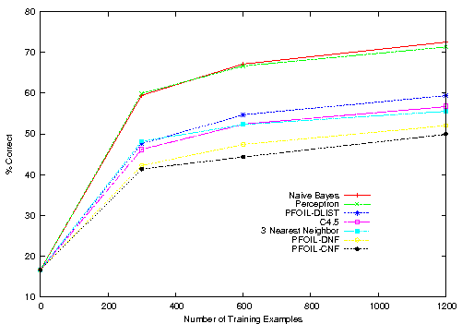
Learning Curves for WSD of “line”
NLP-Prof. M.M.A. Hashem

Slide 100
Discussion of
Learning Curves for WSD of “line”
Naïve Bayes and Perceptron give the best results.
Both use a weighted linear combination of evidence from many features.
Symbolic systems that try to find a small set of relevant features tend to overfit the training data and are not as accurate.
Nearest neighbor method that weights all features equally is also not as accurate.
Of symbolic systems, decision lists work the best.
NLP-Prof. M.M.A. Hashem

Slide 101
Other Syntactic Tasks
NLP-Prof. M.M.A. Hashem

Slide 102
Word Segmentation
Breaking a string of characters (graphemes) into a sequence of words.
In some written languages (e.g. Chinese) words are not separated by spaces.
Even in English, characters other than white-space can be used to separate words [e.g. , ; . - : ( ) ]
Examples from English URLs:
  jumptheshark.com ⇒ jump the shark .com
  myspace.com/pluckerswingbar
  ⇒ myspace .com pluckers wing bar
  ⇒ myspace .com plucker swing bar
⊗
NLP-Prof. M.M.A. Hashem

Slide 103
Morphological Analysis
Morphology is the field of linguistics that studies the internal structure of words. (Wikipedia)
A morpheme is the smallest linguistic unit that has semantic meaning (Wikipedia)
  e.g. “carry”, “pre”, “ed”, “ly”, “s”
Morphological analysis is the task of segmenting a word into its morphemes:
  carried ⇒ carry + ed (past tense)
  independently ⇒ in + (depend + ent) + ly
  Googlers ⇒ (Google + er) + s (plural)
  unlockable ⇒ un + (lock + able) ?
  ⇒ (un + lock) + able ?
NLP-Prof. M.M.A. Hashem

Slide 104
Part Of Speech (POS) Tagging
Annotate each word in a sentence with a part-of-speech.
Useful for subsequent syntactic parsing and word sense disambiguation.
I ate the spaghetti with meatballs.
Pro V Det N Prep N
John saw the saw and decided to take it to the table.
PN V Det N Con V Part V Pro Prep Det N
NLP-Prof. M.M.A. Hashem

Slide 105
Phrase Chunking
Find all non-recursive noun phrases (NPs) and verb phrases (VPs) in a sentence.
  [NP I] [VP ate] [NP the spaghetti] [PP with] [NP meatballs].
  [NP He ] [VP reckons ] [NP the current account deficit ] [VP will narrow ] [PP to ] [NP only # 1.8 billion ] [PP in ] [NP September ]
NLP-Prof. M.M.A. Hashem

Slide 106
Other Semantic Tasks
NLP-Prof. M.M.A. Hashem

Slide 107
Semantic Role Labeling (SRL)
For each clause, determine the semantic role played by each noun phrase that is an argument to the verb.
  agent patient source destination instrument
  John drove Mary from Austin to Dallas in his Toyota Prius.
  The hammer broke the window.
Also referred to a “case role analysis,” “thematic analysis,” and “shallow semantic parsing”
NLP-Prof. M.M.A. Hashem

Slide 108
Semantic Parsing
A semantic parser maps a natural-language sentence to a complete, detailed semantic representation (logical form).
For many applications, the desired output is immediately executable by another program.
Example: Mapping an English database query to Prolog:
  How many cities are there in the US?
  answer(A, count(B, (city(B), loc(B, C),
  const(C, countryid(USA))),
  A))
NLP-Prof. M.M.A. Hashem

Slide 109
Textual Entailment
Determine whether one natural language sentence entails (implies) another under an ordinary interpretation.
NLP-Prof. M.M.A. Hashem

Slide 110
Textual Entailment Problems from PASCAL Challenge
TEXT | HYPOTHESIS | ENTAIL MENT
Eyeing the huge market potential, currently led by Google, Yahoo took over search company Overture Services Inc last year. | Yahoo bought Overture. | TRUE
Microsoft's rival Sun Microsystems Inc. bought Star Office last month and plans to boost its development as a Web-based device running over the Net on personal computers and Internet appliances. | Microsoft bought Star Office. | FALSE
The National Institute for Psychobiology in Israel was established in May 1971 as the Israel Center for Psychobiology by Prof. Joel. | Israel was established in May 1971. | FALSE
Since its formation in 1948, Israel fought many wars with neighboring Arab countries. | Israel was established in 1948. | TRUE
NLP-Prof. M.M.A. Hashem

Slide 111
Pragmatics/Discourse Tasks
NLP-Prof. M.M.A. Hashem

Slide 112
Anaphora Resolution/
Co-Reference
Determine which phrases in a document refer to the same underlying entity.
  John put the carrot on the plate and ate it.
  Bush started the war in Iraq. But the president needed the consent of Congress.
Some cases require difficult reasoning.
    Today was Jack's birthday. Penny and Janet went to the store. They were going to get presents. Janet decided to get a kite. "Don't do that," said Penny. "Jack has a kite. He will make you take it back."
NLP-Prof. M.M.A. Hashem

Slide 113
Ellipsis Resolution
Frequently words and phrases are omitted from sentences when they can be inferred from context.
  "Wise men talk because they have something to say;
  fools talk because they have to say something.“ (Plato)
  "Wise men talk because they have something to say;
  fools, because they have to say something.“ (Plato)
NLP-Prof. M.M.A. Hashem

Slide 114
Other Tasks
NLP-Prof. M.M.A. Hashem

Slide 115
Information Extraction (IE)
Identify phrases in language that refer to specific types of entities and relations in text.
Named entity recognition is task of identifying names of people, places, organizations, etc. in text.
people organizations places
  Michael Dell is the CEO of Dell Computer Corporation and lives in Austin Texas.
Relation extraction identifies specific relations between entities.
  Michael Dell is the CEO of Dell Computer Corporation and lives in Austin Texas.
NLP-Prof. M.M.A. Hashem

Slide 116
Question Answering
Directly answer natural language questions based on information presented in a corpora of textual documents (e.g. the web).
  When was Barack Obama born? (factoid)
    August 4, 1961
  Who was president when Barack Obama was born?
    John F. Kennedy
  How many presidents have there been since Barack Obama was born?
    9
NLP-Prof. M.M.A. Hashem

Slide 117
Text Summarization
Produce a short summary of a longer document or article.
  Article: With a split decision in the final two primaries and a flurry of superdelegate endorsements, Sen. Barack Obama sealed the Democratic presidential nomination last night after a grueling and history-making campaign against Sen. Hillary Rodham Clinton that will make him the first African American to head a major-party ticket. Before a chanting and cheering audience in St. Paul, Minn., the first-term senator from Illinois savored what once seemed an unlikely outcome to the Democratic race with a nod to the marathon that was ending and to what will be another hard-fought battle, against Sen. John McCain, the presumptive Republican nominee….
  Summary: Senator Barack Obama was declared the presumptive Democratic presidential nominee.
NLP-Prof. M.M.A. Hashem

Slide 118
Machine Translation (MT)
Translate a sentence from one natural language to another.
  Hasta la vista, bebé ⇒
  Until we see each other again, baby.
NLP-Prof. M.M.A. Hashem

Slide 119
NLP Conclusions
The need for disambiguation makes language understanding difficult.
Levels of linguistic processing:
  Syntax
  Semantics
  Pragmatics
CFGs can be used to parse natural language but produce many spurious parses.
Statistical learning methods can be used to:
  Automatically learn grammars from (annotated) corpora.
  Compute the most likely interpretation based on a learned statistical model.
NLP-Prof. M.M.A. Hashem

